Slide 1
Mrs. Acker’s Classroom Procedures

Slide 2
Welcome to Environmental Science
In Environmental Science this year, we will be learning about:
1. Scientific Processes and measurements
2. Ecology: Organization of Life; How ecosystems work; Biomes; Aquatic Systems
3. Populations: Understanding populations; biodiversity
4. Water, Land , and Air
5. Natural Resources
6. The Environment and Human Health

Slide 3
Supplies
You will need to have a three ring binder for this class.
Make sure you have dividers.
Pockets would be great. It will give you a place to keep projects that can’t be punched.

Slide 4
Beginning of every Class
We will have a Fact of the Day and/or an Essential Question.
Write down the fact and the question every day as soon as you get to your seat.
If you can’t answer the question before class, you should be able to answer it after class.
Keep these in your notebook. They may be included in the weekly open notes quiz.

Slide 5
Weekly Quiz
We will have an open notebook quiz every Friday.
Anything that should be in your notebook can be on the quiz.
It is important that you keep your notebook organized and up to date.
For the quiz – you must use your own work. No computer printouts, copies of others’ work, or photos of work.

Slide 6
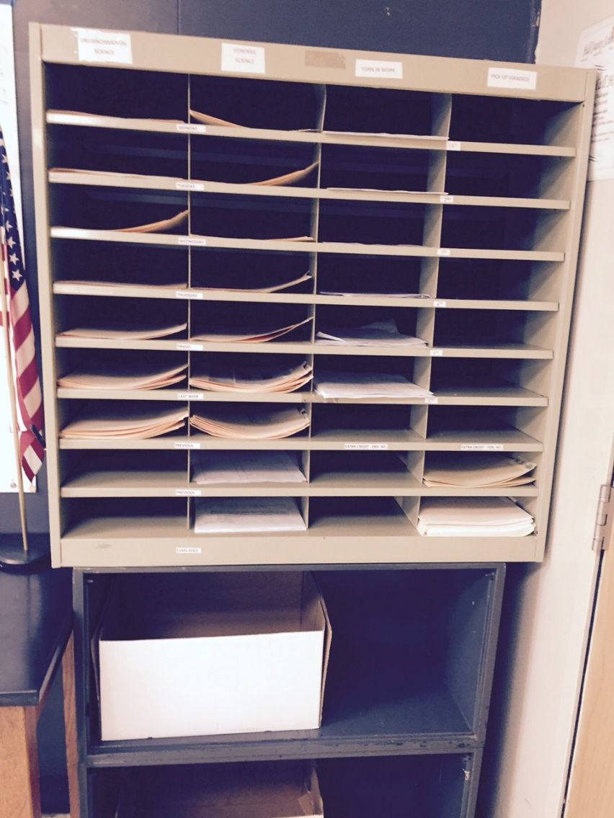
Absences
If you miss class, you are responsible for getting any make up work.
Any handouts will be in the organizer at the front of the room.

Slide 7
Absences
The EQ and FOD will be on my lesson plan on the white board. If you were absent, you may get the EQ and FOD from my lesson plan. (Only if you were absent!)
Check with Mrs. Acker for any other missed assignments.
It is your responsibility to schedule make-up tests and quizzes.

Slide 8
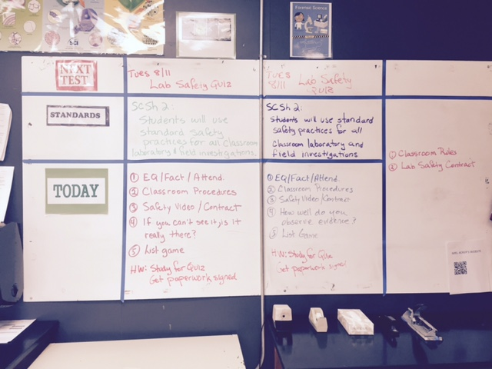
Daily Schedule
The white board closest to the door is your best friend! You can check to see when the next test is, see what homework you have, and know what we will be doing each day. So no one needs to ask me, “What are we doing today?” It’s all right here.

Slide 9
Tests and Quizzes
All test dates, homework and assignments are posted at the front of the room.
Test dates will be posted several days before the test, usually more than a week before the test.
There is no excuse for not knowing what is due and when.
Tests will not be a surprise.

Slide 10
Communications
Sign up for REMIND!
I think it will be a great tool. It now gives me the capability to send messages to individual students.
Text @Ackerenv to 81010
You should get a confirmation text
WEBSITE: ackerscience.weebly.com

Slide 11
CLASSWORK / HOMEWORK
I will give you ample time to complete most of your work in class.
If class work is not completed, it becomes homework.
Depending on your classroom effort, it may be counted as late.
Don’t put off doing classwork because you think you will do it at home.
Do it in class!

Slide 12
CLASSWORK / HOMEWORK
I don’t like too much homework.
You will occasionally have homework if it is needed to reinforce concepts learned in class.
Just because you don’t have assigned homework, doesn’t mean you get a free pass.
Science class requires a lot of work.
You WILL need to study.
Waiting until the night before the test will not cut it. If you need worksheets to help you study, I can provide them.

Slide 13
LATE WORK
I will accept late work.
Late work will have an automatic 10% deduction.
If you make arrangements with me and turn it in on before the prearranged deadline, you will only have a 10% deduct.
Arrangements must be made BEFORE due date.
No arrangements = 10% per day deduct.
All late work must be COMPLETE to get credit – no partial work.

Slide 14
RETAKES
If you do better on a Unit Test than you did on a Chapter Test, Quiz, or other assignment - I will give you the higher score for the other work.
Test grades can replace quiz grades, quiz grades can replace daily work grades, etc.
ONE REPLACED GRADE PER UNIT

Slide 15
CHEATING
If you are given a 0 for cheating – it stays a 0 and you will face additional consequences.
All 0 grades can be changed by completing a substantial project.
You will have 1 opportunity and no more. “Sharing” information in the computer lab is considered cheating.
There will be assignments where you work in teams, but if you are to work on your own – it needs to be your own work.

Slide 16
FOOD/DRINKS/GUM
No food or sugary drinks!
I had a problem with rats and ants in the past because I allowed food in the room. They are gone and I don’t want them back.
If you are really hungry and need a snack. You may eat it quickly outside the glass door. I will not count you tardy if you ask me first.

Slide 17
BOTTLED WATER
Bad for the environment
bad for your health and the health of others
and bad for your wallet.
Bring a refillable container of some kind. If you must use plastic water or soda bottles – RECYCLE!!

Slide 18
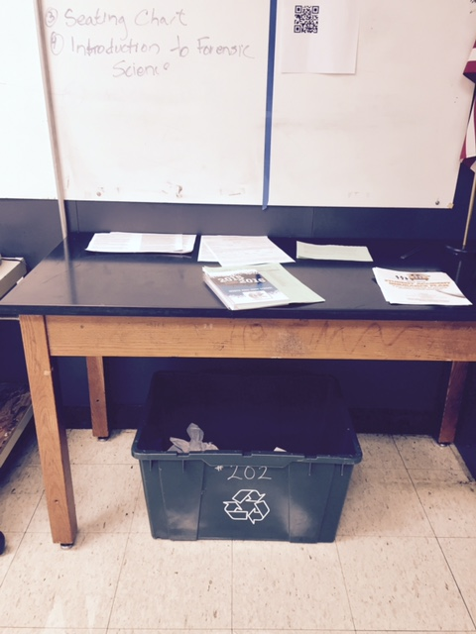
RECYCLE
Our recycling bin is under this desk.
Put paper, plastic, and glass in there.
NO FOOD! (or food wrappers)
Empty your bottles before you put them in there. We have sinks!

Slide 19
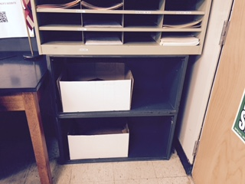
LOST AND FOUND
In boxes by the door.

Slide 20
RULES
DO NOT use the sinks for anything other than washing your hands and disposing of liquids.
They are NOT trash receptacles. They are not your locker.
Stay out of the drawers and cabinets in the back.
Don’t touch anything on my desk.
Don’t take things from my lab bench without permission.
Violation may result in detention and/ or an Administrative Referral.

Slide 21
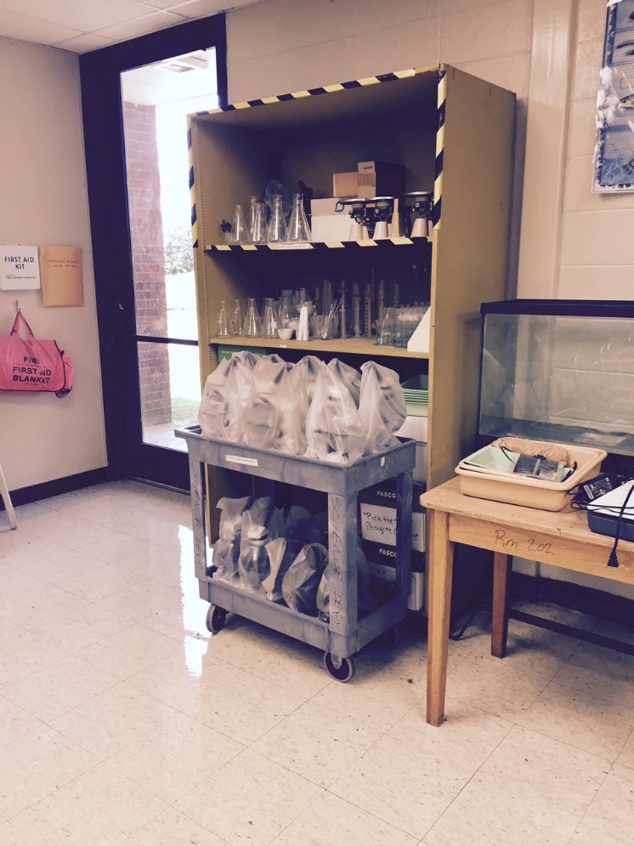
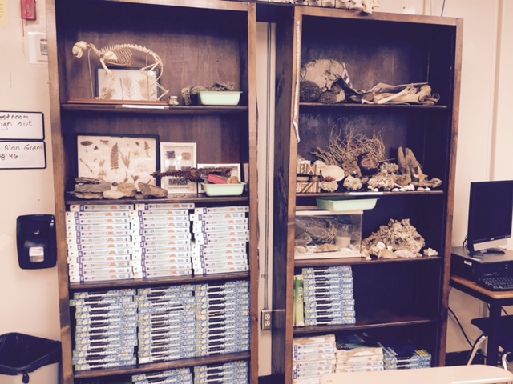
RULES
DON’T TOUCH ANY OF THE ARTIFACTS OR LAB EQUIPMENT!

Slide 22
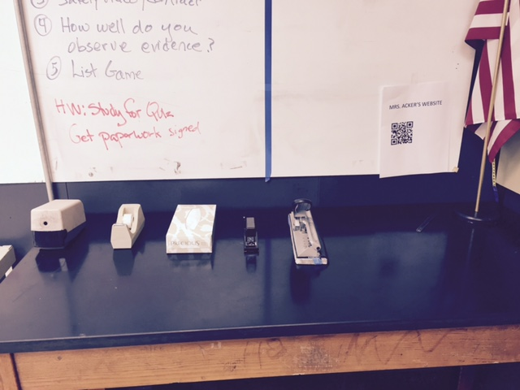
SUPPLIES
There is a pencil sharpener, hole-punch, stapler and tape on this desk for your use.
There is also a bin for work with no name.
If you think you turned in an assignment, but you have a 0, check to see if you forgot to put your name on it.

Slide 23
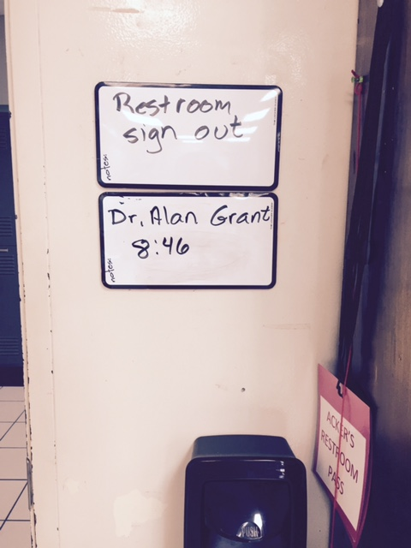
RESTROOM
If you need to use the restroom, sign out.
Take the pass and write your name and the time on the sign out board.
If I’m teaching – wait (unless it is a real emergency) until we are doing independent or group work.

Slide 24
HALL PASS
If you need to go someplace else, check with me.
I’ll sign your AGENDA.
Write down your name, time, and destination on the sign out board.

Slide 25
TEXTBOOK
We will be using this textbook this year. You can not check one out. We will have a class set of books.

Slide 26
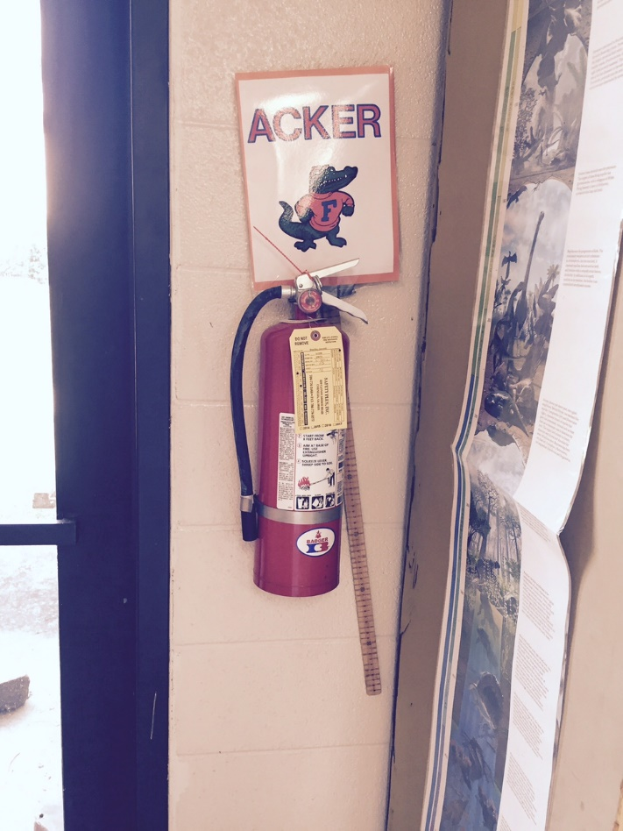
EXITS
You may use either door to enter and leave the room. During the winter, on very cold days, I will ask you not to use the glass door. I will put a sign on the door on those days.
Fire Exit is the rear door.
First one out takes the sign.
Emergency Weather exit is the hall door.

